Slide 1
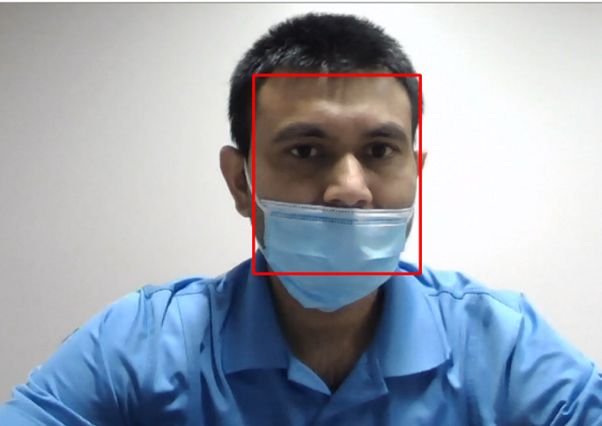
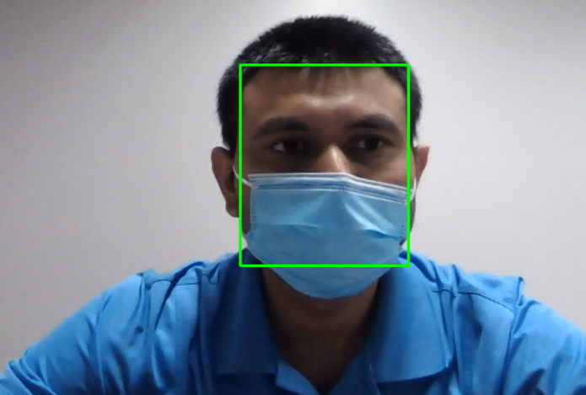
Proper Usage of Face Masks: Automated Detection Using Artificially Generated Dataset and Deep Learning Methods
Submitted By
Mahesh Dhaka(1099371)
Supervised By
Dr. Quazi Abidur Rahman

Slide 2
Problem Statement
In the wake of Covid-19, an increasing number of individuals are not following the face mask guidelines
Some individuals do not put on the masks at all, while others do not cover their mouth, nose, or chin appropriately.
The most common way of incorrectly wearing a face mask is to keep the nose out of the mask and wear it on the rest of the face.
It can be a tedious task for authorities to monitor such individuals.

Slide 3
Purposed Solution
The research purposes to detect whether people are wearing face masks properly or not using deep learning.
It attempts to solve this issue by using a Convolution Neural Network model.

Slide 4
Dataset Description
There are a total of three datasets got used during the entire experiment.
MaskedFaceNet Dataset (Dataset1)
Kaggle Dataset (Dataset2)
SCFace Dataset (Dataset3)

Slide 5
MaskedFaceNet Dataset (Dataset1)
Masked Face Images 137016 Images
Correctly Masked Faces 49% Total 67193 Images
Incorrectly Masked Faces 51% Total 69823 Images
Only mouth and chin masked 80% Total 55857 Images
Only nose and mouth masked 10% Total 6983 Images
Only chin masked 10% Total 6983 Images

Slide 6
Kaggle Dataset (Dataset2)
Masked Face Images 2837 Images
Correctly Masked Faces Total 2287 Images
Incorrectly Masked Faces Total 550 Images
NO Mask Total 418 Images
Incorrectly Masked Total 132 Images

Slide 7
SCFace Dataset (Dataset3)
Masked Face Images 5935 Images
Correctly Masked Faces Total 2844 Images
Incorrectly Masked Faces Total 3091 Images
Only nose and mouth masked Total 948 Images
Only mouth and chin masked Total 948 Images
Only chin masked Total 948 Images
No Face Mask Total 237 Images

Slide 8
Dataset1 Preprocessing
Loading data in two separate arrays, one for correctly masked faces and another one for incorrectly masked faces
Grayscale conversion
Image size reduction to 16X16
Save data for later use

Slide 9
Dataset2 Preprocessing
Locate and crop faces in the images using coordinates of faces in a given XML file.
Create two different array faces images, one for correctly masked faces and another for incorrectly masked faces using provided labels in the XML files.
Reduce image size to 16X16
Save data for later use

Slide 10
Dataset3 Preprocessing
Detect facial coordinates in images using MTCNN.
Apply various types of face masks on faces using their facial key points.
Reduce image size to 16X16
Save data for later use
Dynamically Imposing face masks on people’s faces is one of the key contributions of this research. It cannot be done manually because around 6000 face mask images need to be prepared for Dataset3.

Slide 11
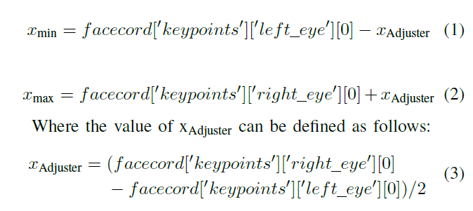
Dataset3 Preprocessing Cont..
The experiment extracts the key values of ‘left eye’, ‘right eye’, ‘nose’, ‘mouth left’, ‘mouth right’ from the ‘keypoints’ JSON object.
These values provide the exact facial key-points required to dynamically impose a face mask.
For the research, there is a need to prepared four different types of images: Correctly Masked Face, Only Mouth and Chin Masked, Only Nose and Mouth Masked, and Only Chin Masked.
If ‘facecord’ is a returned JSON object from the MTCNN model, xmin and xmax can be defined in Eq1 and Eq2 respectively.

Slide 12

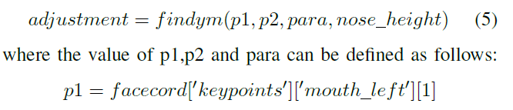

Dataset3 Preprocessing Cont..
The value of ymax remains same for three out of four masked faces categories: Correctly Masked Faces, Only Mouth and Chin Masked, and Only Chin Masked. It can be calculate as follow:
The value of the ‘adjustment’ factor is one of the most complex calculations in this entire experiment. It is calculated using a function called ‘findym’

Slide 13
Dataset3 Preprocessing Cont..
The ‘findym’ function is a recursive function and got used to maximize the value of ‘adjustment’.
The function maximizes the value in a way that y_{max} should not be more than the maxim height of the image.
The value of adjustment should also not be more than 2.8 times the height difference between mouth and nose coordinates.
To calculate the value of ymax for Only Nose and Mouth Masked category following equation can be used.
However, calculating ymin is not that simple and changes from Correctly Masked Faces to Incorrectly Masked Faces and even also within the subcategories of Incorrectly Masked Faces.
Let’s first calculate the value of ymin for Correctly Masked Faces.

Slide 14
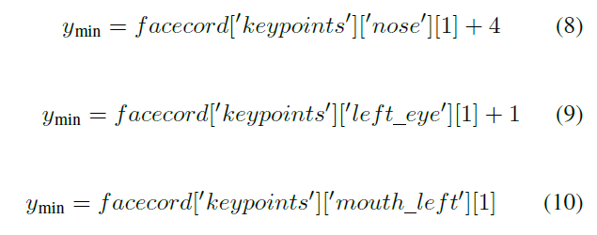
Dataset3 Preprocessing Cont..
The value of ymin for Only Mouth and Chin Masked, Only Nose and Mouth Masked, and Only Chin Masked category can be calculated using the following equations respectively.
Once we have xmin, xmax, ymin, and ymax, it can be used to put different types and colors of masks on faces for the respective Masked Faces categories.

Slide 15
Methods
There are several method got used to perform the experiment:
CNN
MTCNN
GAN

Slide 16
Multi-task Cascaded Convolutional Networks (MTCNN)
One of the most effective and currently widely used face detection techniques
The model is based on CNN architecture and typically achieves near to a hundred percent accuracy for high-resolution image datasets
The network can be divided into three parts: P-Net, R-Net, and O-Net.
P-Net takes a image as an input and runs a 12X12 kernel through the image to search for a face.
The output of P-Net is the probability of faces being in each bounding box along with the coordinatesof the bounding box.
The architecture of R-Net is like P-Net with just more layers.
It takes the output of P-Net as an input and returns more accurate bounding box coordinates.
In the end, O-Net takes the output of P-Net as an input and returns 3 sets of output: the probability of faces in a bounding box, the coordinates of the bounding box, and the coordinates of the facial landmarks.

Slide 17
Generative Adversarial Networks(GAN)
It is a machine learning framework designed by Ian Goodfellow in 2014
The framework simultaneously trains two different models: a generative model and a discriminative model.
The first one generates some data using random noise and the second one estimates the probability that the sample came from the training data instead of from the generative model.
The training procedure for the generative model is to maximize the probability of the discriminative model making a mistake.

Slide 18
Experiments
There are a total of 5 experiments got performed on these 3 datasets.
Experiment1: Apply CNN on MaskedFaceNet Dataset(Dataset1)
Experiment2: Apply CNN on Kaggle Dataset(Dataset2)
Experiment3: Apply CNN on SCFace Dataset(Dataset3)
Experiment4: Apply CNN on the merger on all three datasets
Experiment5: Apply CNN on the merger on all three datasets and on additional images generated using GAN

Slide 19
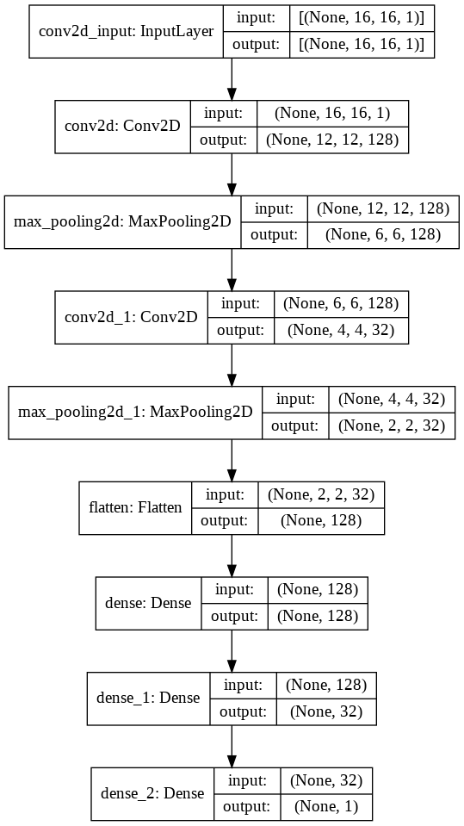
CNN Model Architecture

Slide 20
Experiment1
A CNN model got applied on Dataset1 using 5-fold cross-validation
Accuracy for the Nose and Mouth Covered category is significantly lower than any other category
It is because:
masked faces in this category look almost similar to masked faces in the Correctly Masked Faces category.
detecting chin feature is not as easy as detecting nose and mouth features in an image.
Type of Face Masks | Accuracy
Complete Dataset | 97.90%
Correctly Masked Accuracy | 97.81%
Incorrectly Masked Accuracy(IMF) | 97.99%
IMF Only Chin Covered Accuracy | 98.48%
IMF Mouth and Chin Covered Accuracy | 99.09%
IMF Nose and Mouth Covered Accuracy | 87.64%

Slide 21
Experiment2
A CNN model got applied on Dataset2 using 5-fold cross-validation
Dataset2 doesn’t perform as good as dataset1. It is because:
Limited amount of training data availability.
Correctly Faces Faces category accuracy is higher than Incorrectly Masked Faces because the IncorrectlyMasked Faces category has only 550 images.
Type of Face Masks | Accuracy
Complete Dataset | 91.85%
Correctly Masked Accuracy | 95.58%
Incorrectly Masked Accuracy(IMF) | 76.36%

Slide 22
Experiment3
A CNN model got applied on Dataset3 using 5-fold cross-validation
Experiment3 confirms one of the findings of experiment1:
It can be noticed in both of these experiments that images where the nose and mouth are covered but the chin is not, have lower accuracy in comparison to any other category.
Type of Face Masks | Accuracy
Complete Dataset | 98.06%
Correctly Masked Accuracy | 98.07%
Incorrectly Masked Accuracy(IMF) | 98.05%
IMF Nose Open Accuracy | 96.04%
IMF Nose Mouth Open Accuracy | 98.54%
IMF Chin Open Accuracy | 95.62%
IMF No Mask Accuracy | 97.91%

Slide 23
Experiment4
A CNN model got applied on the dataset prepared from the merger of Dataset1, Dataset2, and Dataset3
Type of Face Masks | Accuracy
Complete Dataset | 97.57%
Correctly Masked Dataset1(MaskedFaceNet) | 99.29%
Incorrectly Masked Dataset1(MaskedFaceNet) | 98.08%
Correctly Masked Dataset2(Kaggle) | 87.93%
Incorrectly Masked Dataset2(Kaggle) | 79.81%
Correctly Masked Dataset3(SCFace) | 97.64%
Incorrectly Masked Dataset3(SCFace) | 97.88%

Slide 24
Experiment5
A CNN model got applied on the dataset prepared from the merger of Dataset1, Dataset2, and Dataset3 and GAN generated images
There is no noticeable performance difference between experiment4 and experiment5 despite tacking the issue of class imbalance using GAN.
Type of Face Masks | Accuracy
Complete Dataset | 97.51%
Correctly Masked Dataset1(MaskedFaceNet) | 97.96%
Incorrectly Masked Dataset1(MaskedFaceNet) | 97.51%
Correctly Masked Dataset2(Kaggle) | 89.63%
Incorrectly Masked Dataset2(Kaggle) | 74.72%
Correctly Masked Dataset3(SCFace) | 99.33%
Incorrectly Masked Dataset3(SCFace) | 95.78%

Slide 25
Gan no performance improvement reason
GAN model does not have enough training data for the training.
Hence, the quality of GAN-generated images is significantly poor in comparison to original images.

Slide 26
Comparative analysis between all the experiments
It can be seen that Dataset3 slightly outperforms all other datasets. It is because:
One of the reasons behind that is it includes images of subjects with different types and colors of face masks.
It also has images of humans with different angles for example Front, Left, Right.
It also doesn’t have misclassified images.
Model | Accuracy | CMFA | IMFA
CNN Dataset1 | 97.90 | 97.81 | 97.99
CNN Dataset2 | 91.85 | 95.58 | 76.36
CNN Dataset3 | 98.06 | 98.07 | 98.05
CNN Merged Dataset | 97.57 | 97.71 | 97.22
CNN Merged D. GAN | 97.51 | 97.63 | 97.31

Slide 27
Conclusion
The research concludes that deep learning models can be used for the classification of correctly and incorrectly worn face masks.
The model got classification accuracy of around 98% for Dataset1 and Dataset3 where both the datasets are artificially generated
However, it doesn’t perform relatively well on Dataset2 which is a real-world dataset.
One of the reasons behind that is a relatively small number of images are available in Dataset2 especially in Incorrectly Wore Face Mask Category with only 550 images.
The experiment also uses GAN to generated more images for this category, but it doesn’t help much because such a small size of training sample cannot train the GAN model well enough to generate good quality images
Even though, the earlier research on face mask detection can detect whether people are wearing a face mask or not. It cannot classify whether people are wearing face masks correctly or not.

Slide 28
References
[1] K. Dang and S. Sharma, ”Review and comparison of face detection algorithms,” 2017 7th International Conference on Cloud Computing, Data Science Engineering - Confluence, Noida, 2017, pp. 629-633, doi: 10.1109/CONFLUENCE.2017.7943228.
[2] S. Jing, C. Hu, C. Wang, G. Zhou and J. Yu, ”Vehicle Face Detection Based on Cascaded Convolutional Neural Networks,” 2019 Chinese Automation Congress (CAC), Hangzhou, China, 2019, pp. 5149-5152, doi: 10.1109/CAC48633.2019.8996162.
[3] S. Albawi, T. A. Mohammed and S. Al-Zawi, ”Understanding of a convolutional neural network,” 2017 International Conference on Engineering and Technology (ICET), Antalya, 2017, pp. 1-6, doi: 10.1109/ICEngTechnol.2017.8308186.
[4] Adnane Cabani, Karim Hammoudi, Halim Benhabiles, Mahmoud Melkemi,MaskedFace-Net ˆa A dataset of correctly/incorrectly masked face images in the context of COVID-19,Smart Health,Volume 19,2021,100144,ISSN 2352-6483
[5] Zhang, K., Zhang, Z., Li, Z., and Qiao, Y. (2016). Joint face detection and alignment using multitask cascaded convolutional networks. IEEE Signal Processing Letters, 23(10):1499ˆa1503.
[6] Mislav Grgic, Kresimir Delac, Sonja Grgic, SCface – surveillance cameras face database, Multimedia Tools and Applications Journal, Vol. 51, No. 3, February 2011, pp. 863-879
[7] ”Generative Adversarial Networks.” Ian J. Goodfellow, Jean Pouget- Abadie, Mehdi Mirza, Bing Xu, David Warde-Farley, Sherjil Ozair, Aaron Courville, Yoshua Bengio. ArXiv 2014.
[8] Viola, Paul Jones, Michael. (2001). Rapid Object Detection using a Boosted Cascade of Simple Features. IEEE Conf Comput Vis Pattern Recognit. 1. I-511. 10.1109/CVPR.2001.990517.
[9] Mohamed Loey, Gunasekaran Manogaran, Mohamed Hamed N. Taha, Nour Eldeen M. Khalifa,A hybrid deep transfer learning model with machine learning methods for face mask detection in the era of the COVID- 19 pandemic,Measurement,Volume 167,2021,108288,ISSN 0263-2241
[10] I. B. Venkateswarlu, J. Kakarla and S. Prakash, ”Face mask detection using MobileNet and Global Pooling Block,” 2020 IEEE 4th Conference on Information Communication Technology (CICT), Chennai, India, 2020, pp. 1-5, doi: 10.1109/CICT51604.2020.9312083.
[11] Larxel, (2020, May). Face Mask Detection, Retrieved February 5, 2020 from https://www.kaggle.com/andrewmvd/face-mask-detection

